Slide 1
Introducing Graphics to the Visually Impaired One Pixel at a Time

Slide 2
Introduction
Goals
Demonstrate tool
Graphics Insight
Raise Awareness

Slide 3
Background
I'm a programmer / teacher
Graphics / Pictures are powerful
Blind have limited graphics access

Slide 4
Problems
Little access to graphical presentations
Tools e.g. Braille embossers are expensive – not at everyone's desk
Access - slow/cumbersome

Slide 5
The Tool
Initial goal: Help beginners learn Programming
Extended goal: Graphics for Visually Impaired

Slide 6
Tool Benefits Provided
Braille rendition of simple graphics output
Graphics output with audio feedback
Notes:
Compromises: Lower resolution, Few colors

Slide 7
Non-programming view
Python program
a wordy nerdy "Etch A Sketch" drawing tool
Drawing Instructions

Slide 8
Draw a square
# square_loop.py
# Display a square
from turtle_braille_link import * # graphics
color("green")
for i in range(4): # Do 4 times
forward(200)
right(90)
done() # Complete drawing

Slide 9
A Demo – Hopefully Live
Following slides are reminders
offline viewing
If computer problems
Demo V/I usage…
cmd> cd Desktop\...\01_intro
cmd> python square_loop.py
Notes:
Students copy files to Desktop\braille_2023\
Simplest graphics square.py, square_loop.py

Slide 10
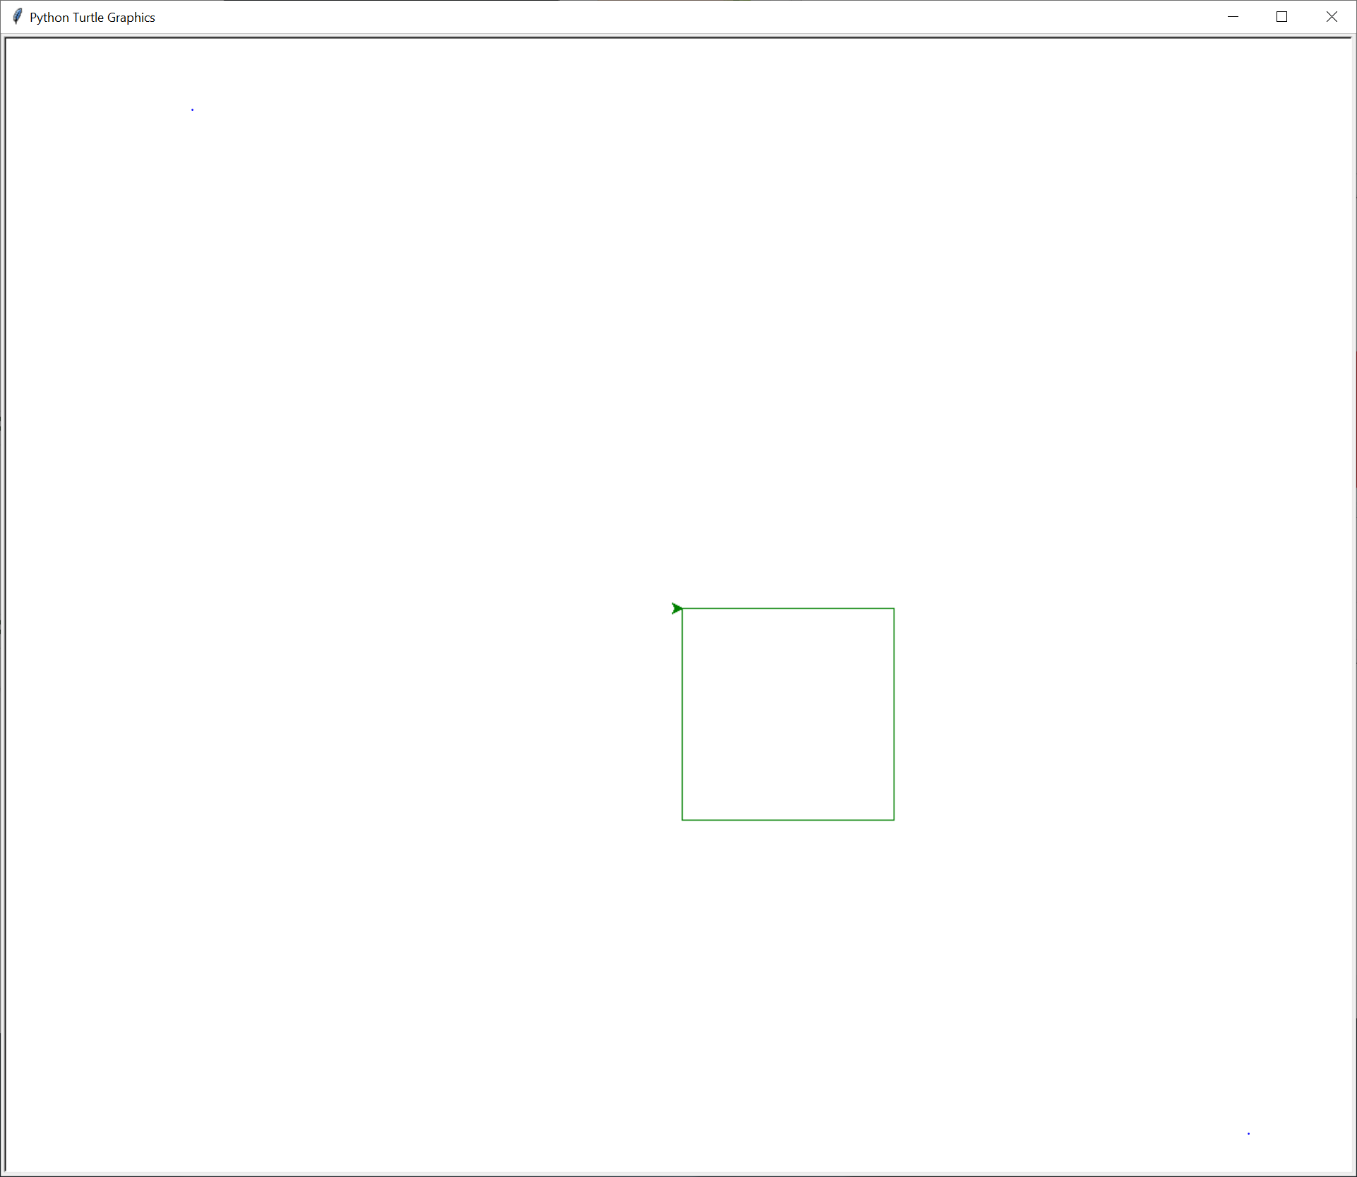
Standard turtle graphical output

Slide 11
Text output – send to Braille embosser
,,gggggggggggg
,,,g,,,,,,,,gg
,,,g,,,,,,,,gg
,,,g,,,,,,,,gg
,,,g,,,,,,,,gg
,,,g,,,,,,,,gg
,,gggggggggggg
Notes:
Commas added to keep blank area from being compressed
Figure moved to left and up to reduce effort to find figure

Slide 12
Changes to Braille text
Spaces to commas
Braille machine compresses spaces
Comma Braille:
Moving figure up to left
Facilitate finding figure

Slide 13
Braille usage steps
Copy text
Transmit Braille machine
Retrieve Braille
Slows viewing → reduces impact

Slide 14
Hope: quick change and quick view
square_loop.py
square_loop_w40.py – thicken lines
square_loop_colors.py – add colors

Slide 15
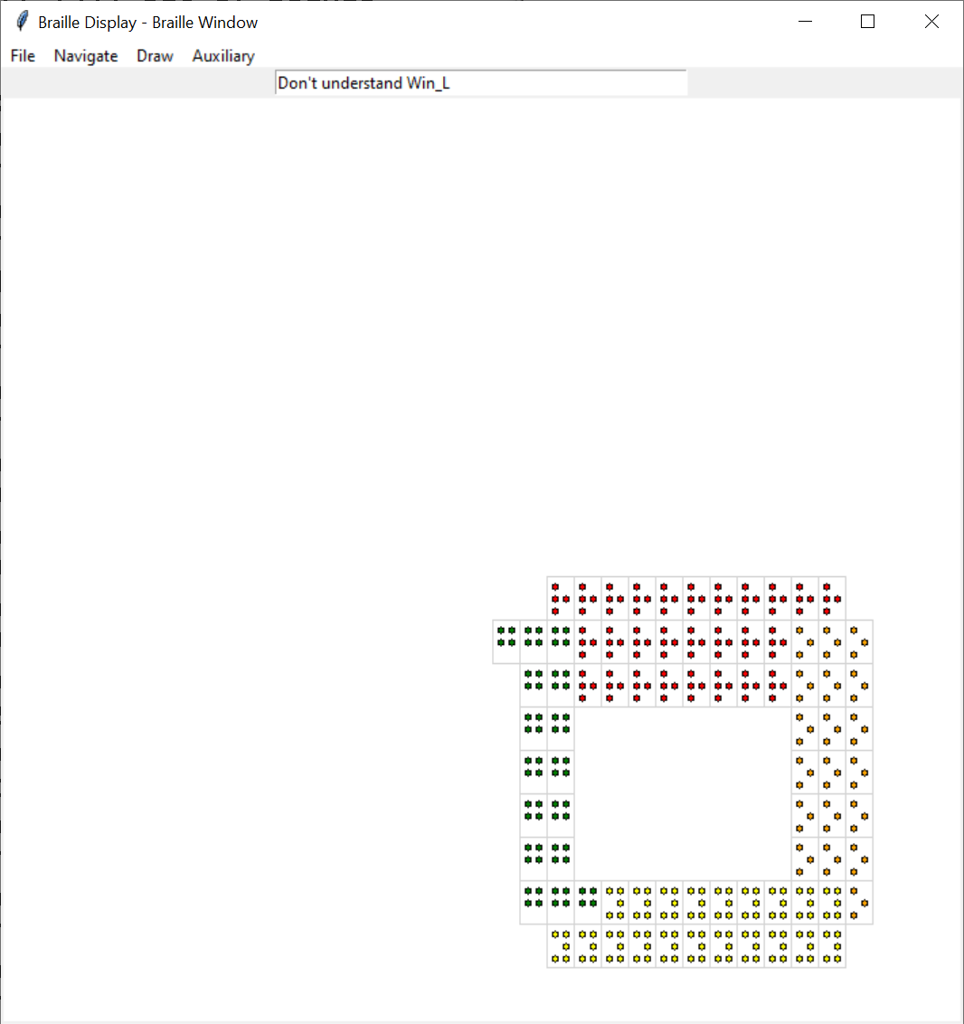
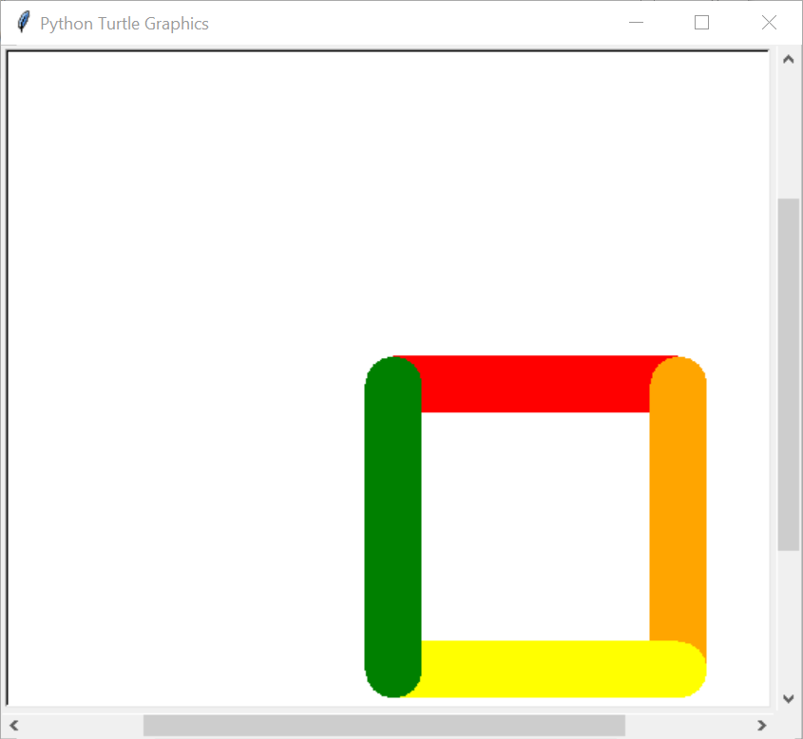
Braille Display Window with Audio Feedback
Notes:
Started as a guide to the implementor
Became an audio based guide

Slide 16
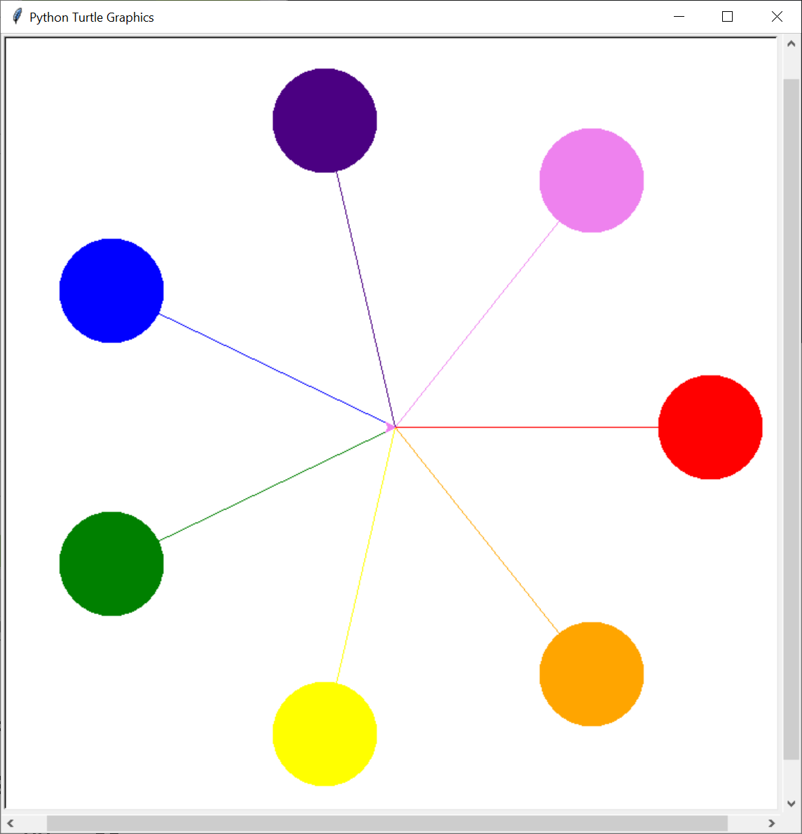
Spokes – A More elaborate figure

Slide 17
Spokes text output
,,,,,,,,,,,,,iii
,,,,,,,,,,,,iiiiii
,,,,,,,,,,,,iiiiii,,,,,,,,vvv
,,,,,,,,,,,,iiiii,,,,,,,vvvvvv
,,,,,,,,,,,,,,,i,,,,,,,,vvvvvv
,,,bbb,,,,,,,,,ii,,,,,,,,vvvvv
,,bbbbb,,,,,,,,,i,,,,,,vvv
,,bbbbbb,,,,,,,,i,,,,,vv
,,bbbbbbbb,,,,,,ii,,,vv
,,,,,,,,,,bbbb,,,i,,v,,,,,,,,,,,rr
,,,,,,,,,,,,,bbbbivv,,,,,,,,,,rrrrrr
,,,,,,,,,,,,,,,,bvvrrrrrrrrrrrrrrrrr
,,,,,,,,,,,,,ggg,yoo,,,,,,,,,,rrrrrr
… Omitted for brevity …

Slide 18
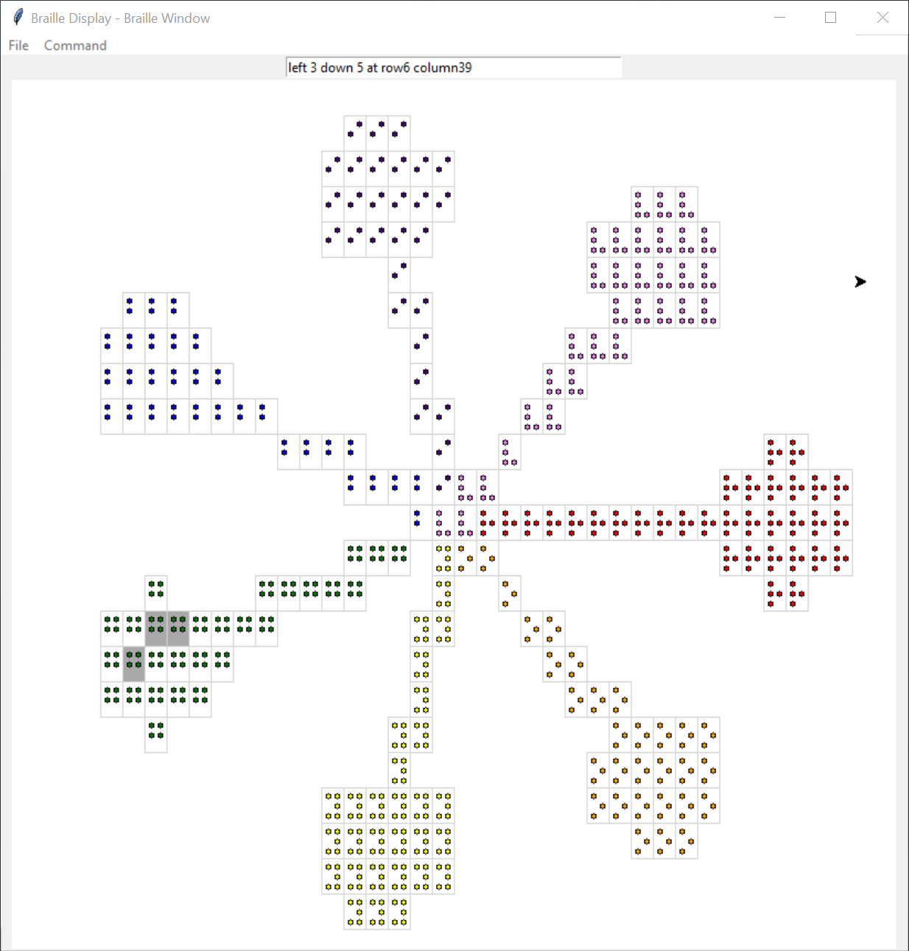
Spokes – Braille Display

Slide 19
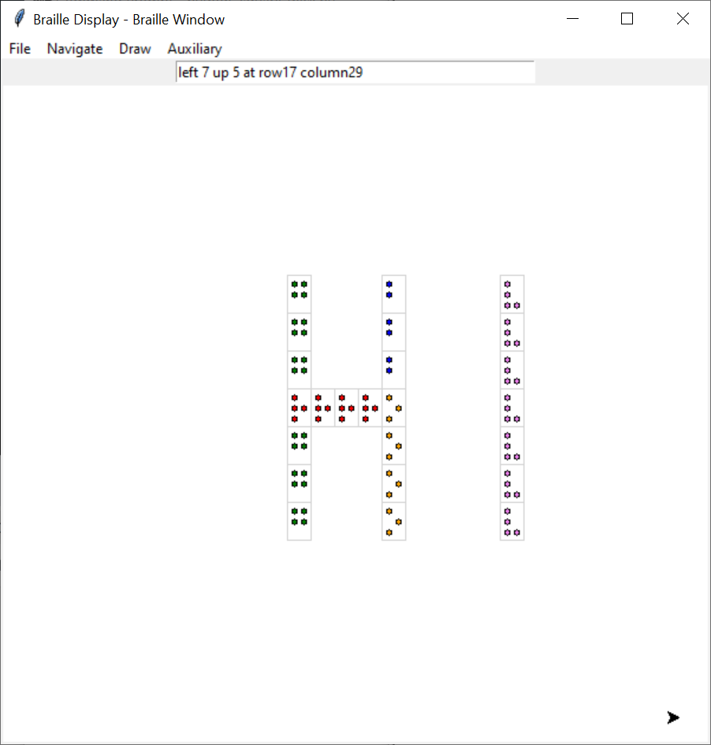
A Drawing Tool
Braille Text
,,g,,,b,,,,v ,,g,,,b,,,,v ,,g,,,b,,,,v ,,rrrro,,,,v ,,g,,,o,,,,v ,,g,,,o,,,,v ,,g,,,o,,,,v

Slide 20
Future Possibilities
Navigational Improvements
Speedups – async audio
Stereo audio feedback, distance, direction, feedback
More intelligent/automatic scanning
Presentation Improvements
Real-time scaling region maginification / selection

Slide 21
Tool Question and Answer

Slide 22
How it was done

Slide 23
A Look Inside
The Plan
Braille rendition of simple Turtle graphics
A text picture to send to the embosser
Coarse – 40 characters by 25 lines
One color letter per square

Slide 24
The Plan continued…
Shadow functions for each Turtle function
Sample points for each visible graphic – e.g. line
Create cells to display from points

Slide 25
The Plan continued…
for each user Turtle function call
Call Turtle's function ➔Turtle graphic
Call shadow function(s)

Slide 26
The Plan continued…
Shadow function – e.g. add_line()
Update shadow state - e.g. color
Create sample points at a higher resolution than display grid
Add new display cell for each new point

Slide 27
The Plan continued…
for Turtle function done or mainloop
If print braille:
Generate text picture from display cells
If braille window:
Create Braille Window Display
Populate with Braille Cells

Slide 28
Turtle Graphic to Display Cells
Shadow call e.g. add_line
Graphic region sample points
Add points from spaced points on perimeter
Divide region into triangles
Add in points from each triangle
For each sample point
If point not inside any display cell:
Create new display cell

Slide 29
Triangle to sample points
Add in spaced points on perimeter
Divide triangle horizontally by spaced vertical lines
Add in spaced points on each vertical line
NOTE: Over sampling does not hurt … much

Slide 30
Braille Display, with Audio Feedback
Initially only a diagnostic aid
Python module tkinter - Canvas, Menu
Display cells created during drawing phase
Dictionary by (cell-x-index, cell-y-index)
Much energy changing between coordinates:
canvas – turtle – cell-indices

Slide 31
Alternate Strategy for Display Cells Road Not Taken
Let most Turtle calls go through unchanged
Scan created Tkinter Canvas
Divide up canvas into display regions (40x25)
For each region find overlapping Canvas items
Where found – create a display cell

Slide 32
Alternate Strategy continued
Benefits:
Simpler
Applicable to non-turtle tkinter programs
Facilitates scale changes
We tried, but ran in to problems

Slide 33
Future Possibilities
Implement some of the Tool Possibilities
Retry the Canvas scanning approach

Slide 34
Source Code
GitHub Project github.com/raysmith619/resource_lib
src/ – source files (Python)
README.md – Short description
Alternate direction, with discussion
raysmith619/TurtleBraille

Slide 35
Implementation Question and Answer

